Slide 1

WELCOME TO
WILLY A. VENTURES

Slide 2
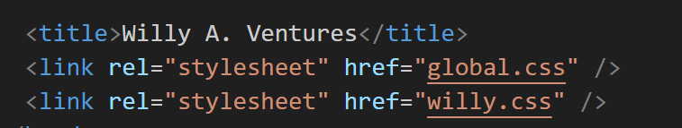
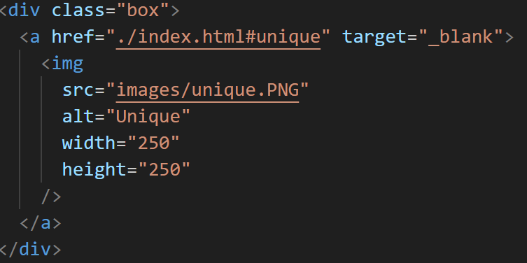
INTRODUCTION
My journey with ReDi
What i learned in ReDi
Relevance for my life
Willy A. Ventures

Slide 3
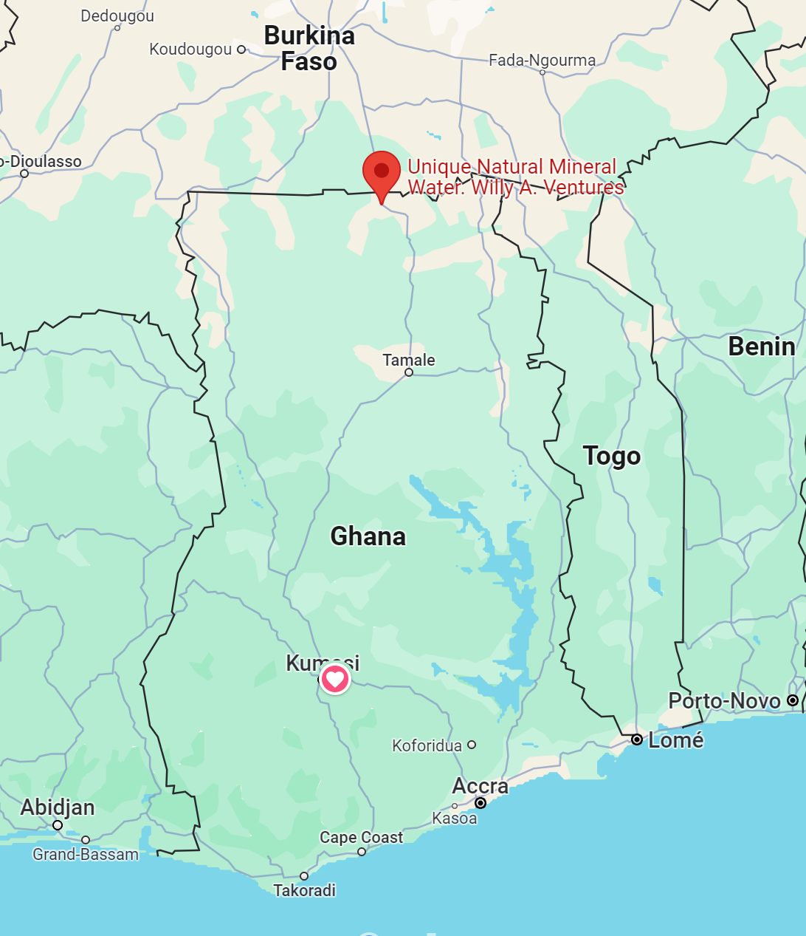
VARIETY OF BUSINESS
Unique Natural Mineral Water
Unique Hostel Services
Unique Rental Service
Unique Construction & Building Material
Unique Fish Production

Slide 4
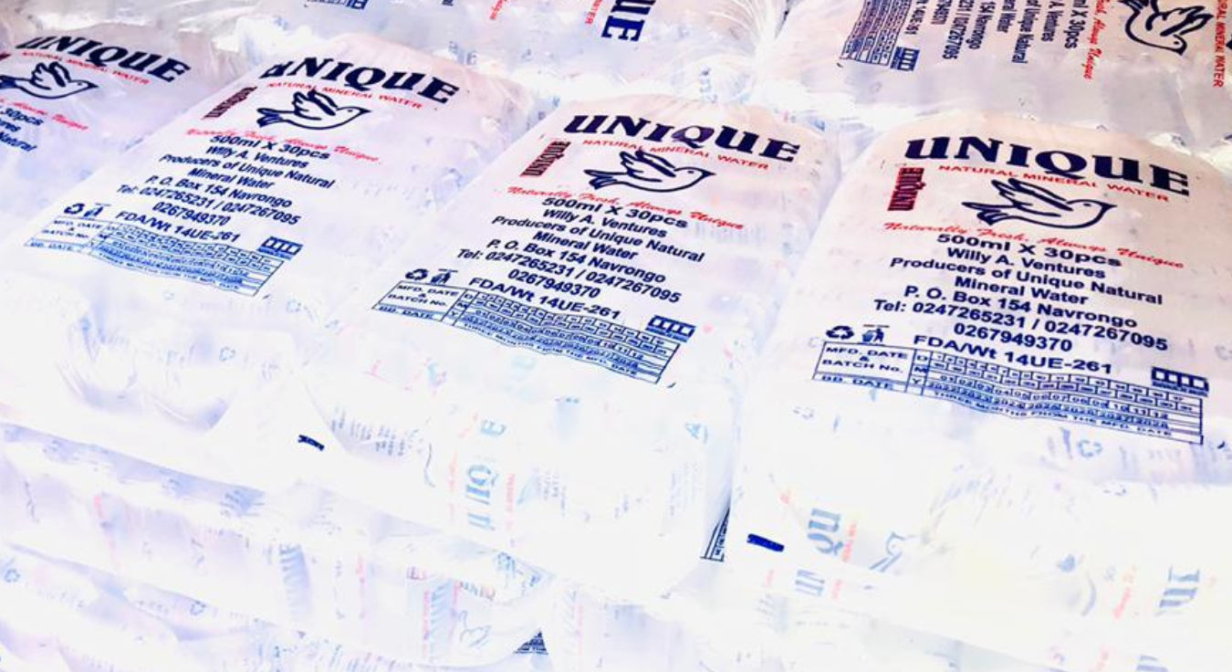
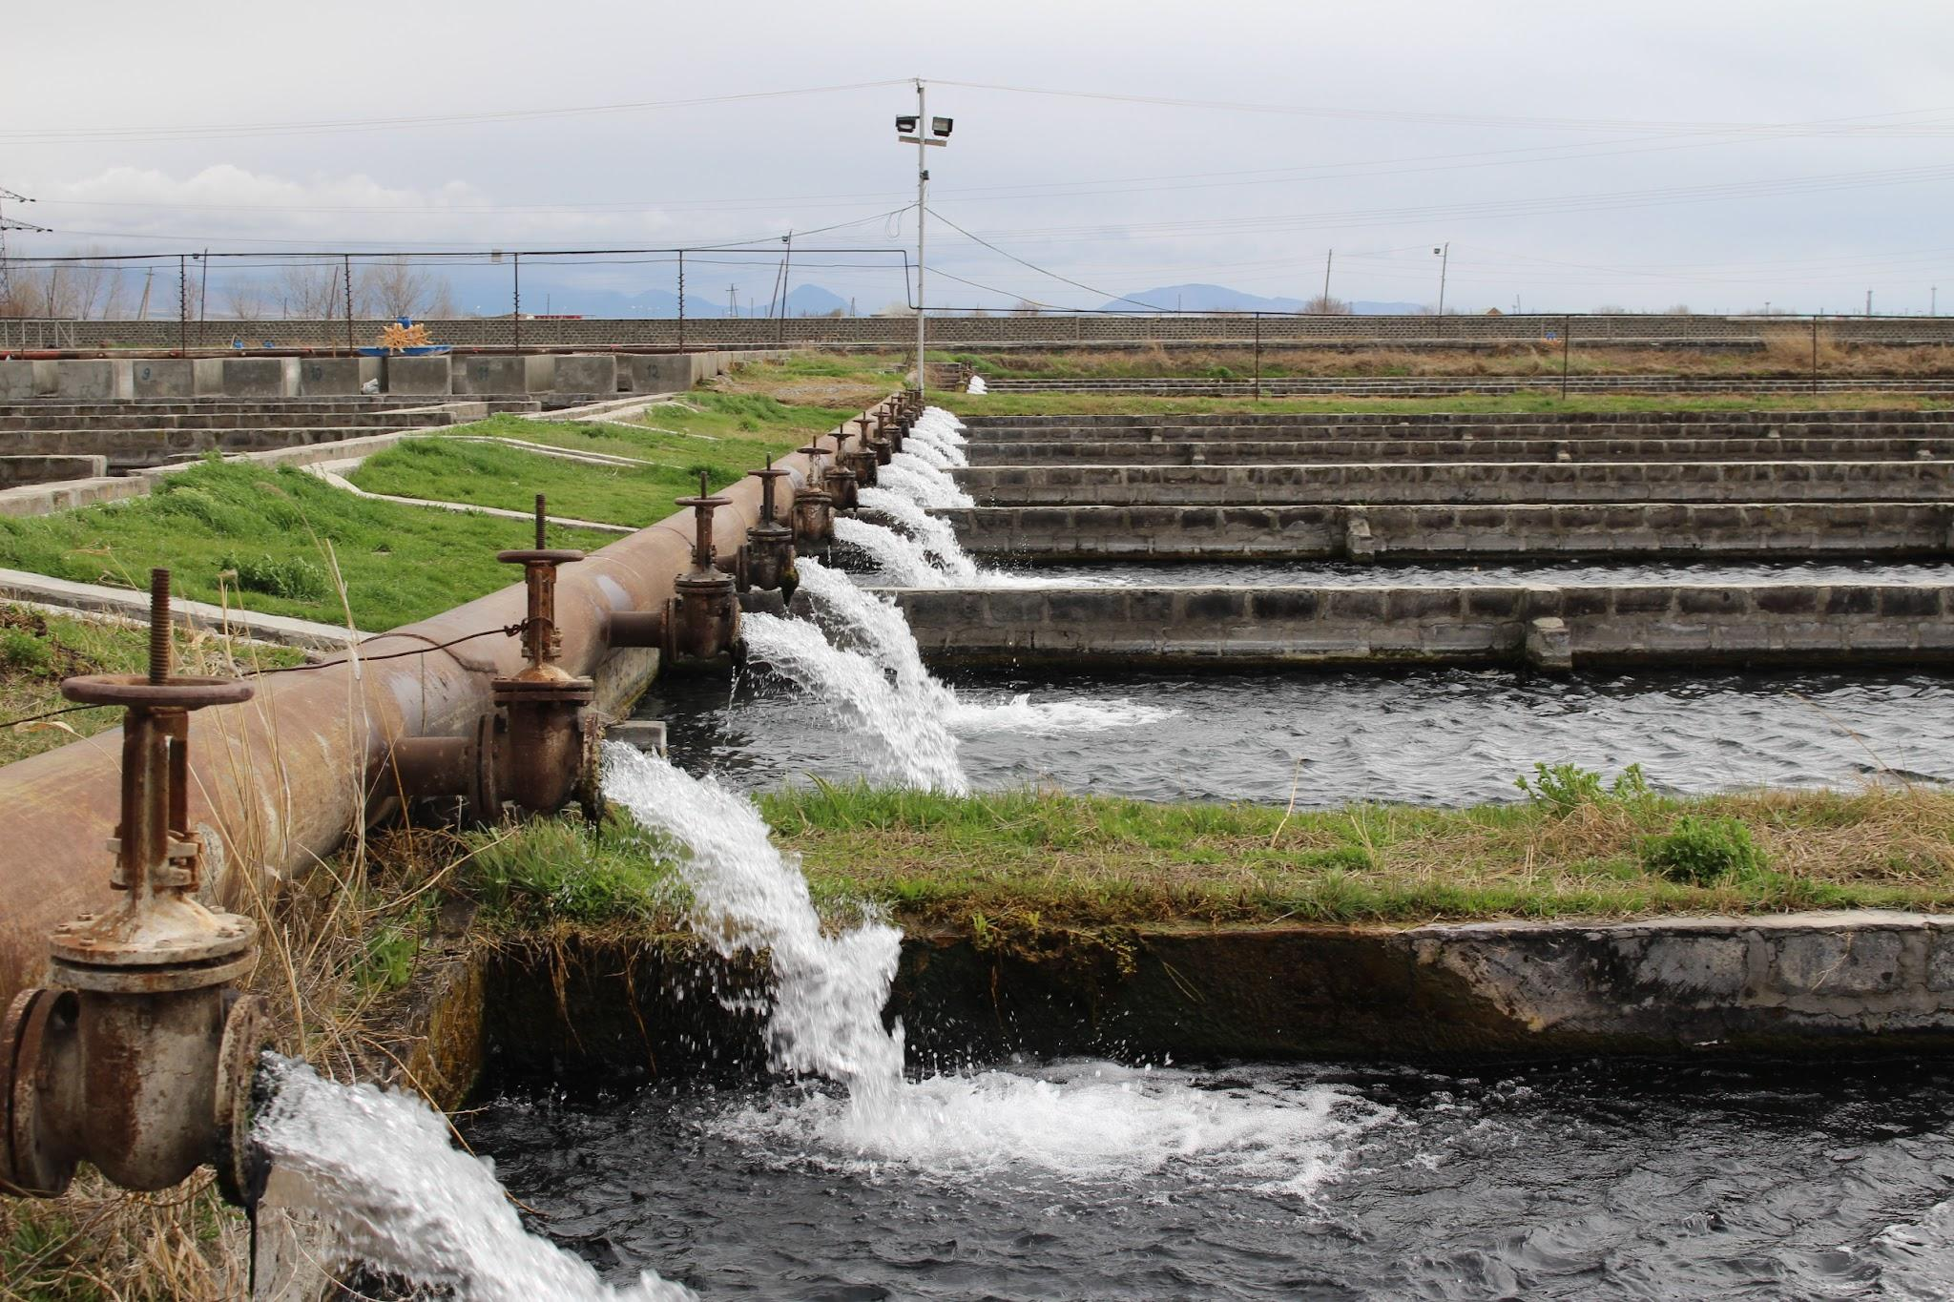
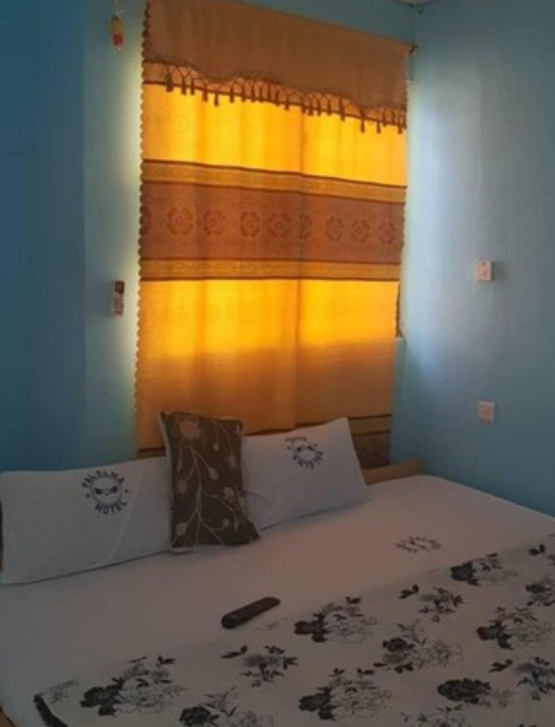
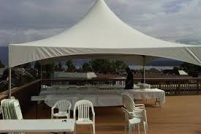


Slide 5
The purpose of the website
Increased visibility and Reach
Credibility and professionalism
Marketing and branding
Customer Engagement and support

Slide 6
I
THANK
YOU
FOR
YOUR
TIME

